Slide 1
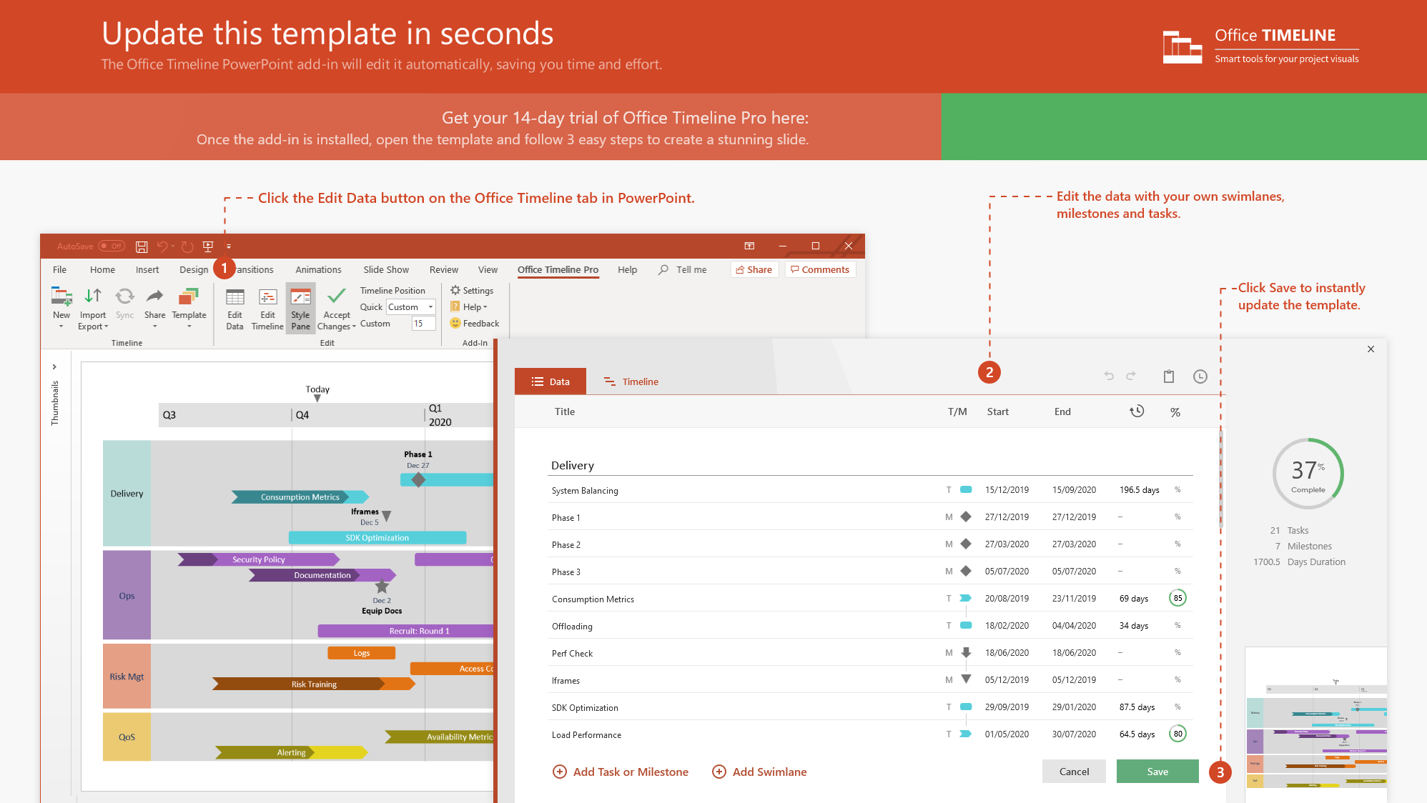
https://www.officetimeline.com/14-days-trial

Slide 2
Minimal Prototype
07/02
-
21/02
Release Web Prototype
Kick-Off
3/1/21
24/01-06/02
Submission
Online Testing
Release
11/25/20
5/20/21
3/15/22
Janvier
Janvier
Avril
Février
2021
2022
Today
7/22/21
1/1/22
10/30/20
Integration
Validation
Exec Review
Cahier de Charge
80%
5/20 - 11/20
73 days
11/20 - 3/21
Coding
73%
127 days
3/21 - 8/21
Code Improvements
56%
44 days
8/21 - 10/21
Stabilization
20%
76 days
8/21 - 11/21
Integration with Website
15%
97 days
10/21 - 2/22
User Acceptance
104 days
1/22 - 5/22
Documentation

